Slide 1
Measuring and communicating effects of MPAs on deep “shoal” fisheries
Mike Cappo, Marcus Stowar, Thomas Stieglitz, Eric Lawrey, Charlotte Johansson, Aaron MacNeil

Slide 2
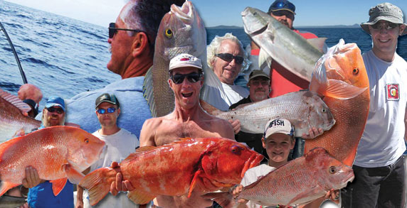
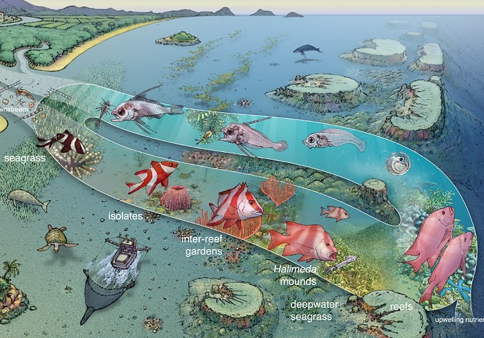
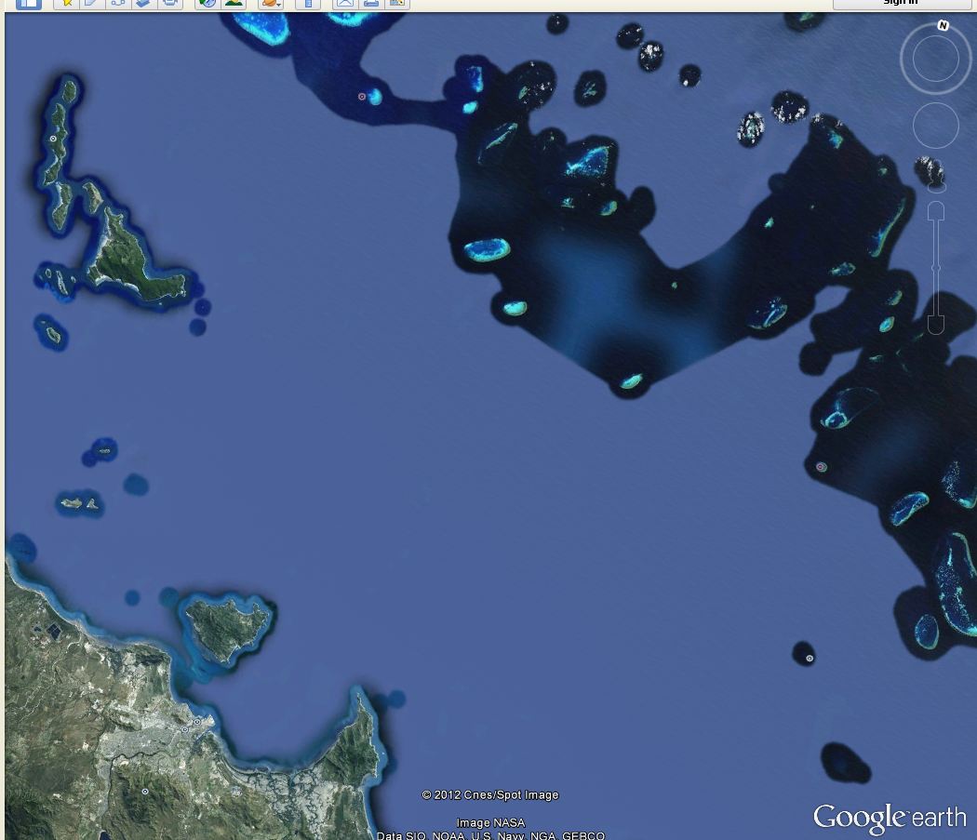
Shift in fishing to inter-reef
?
?
?
?
?
?
?
?
?

Slide 3
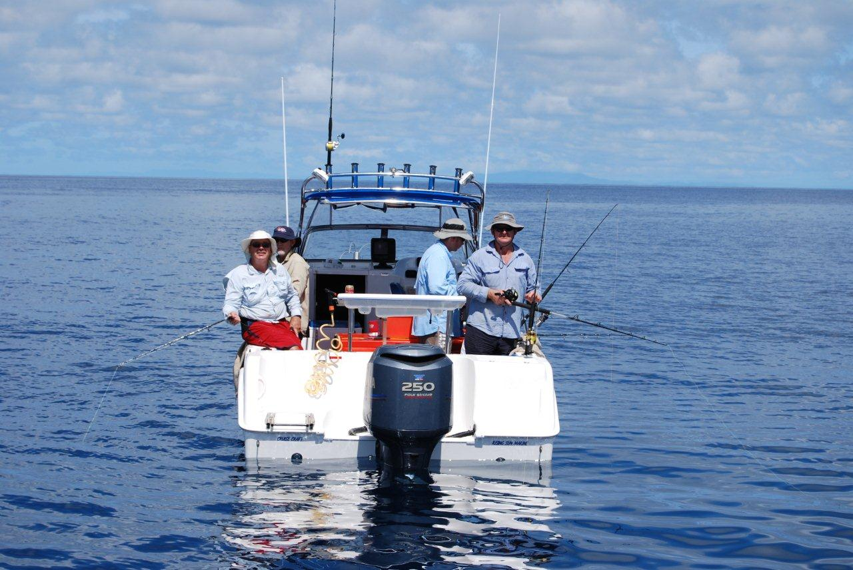
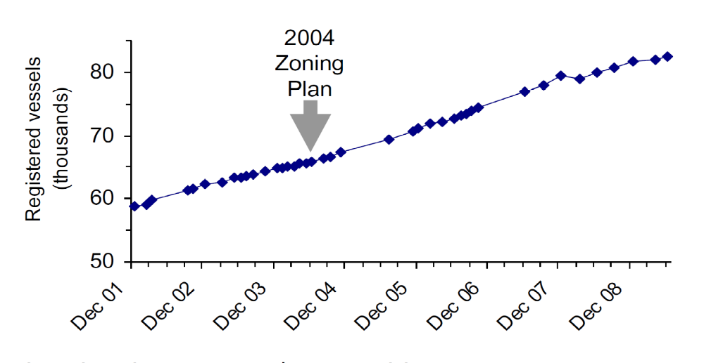
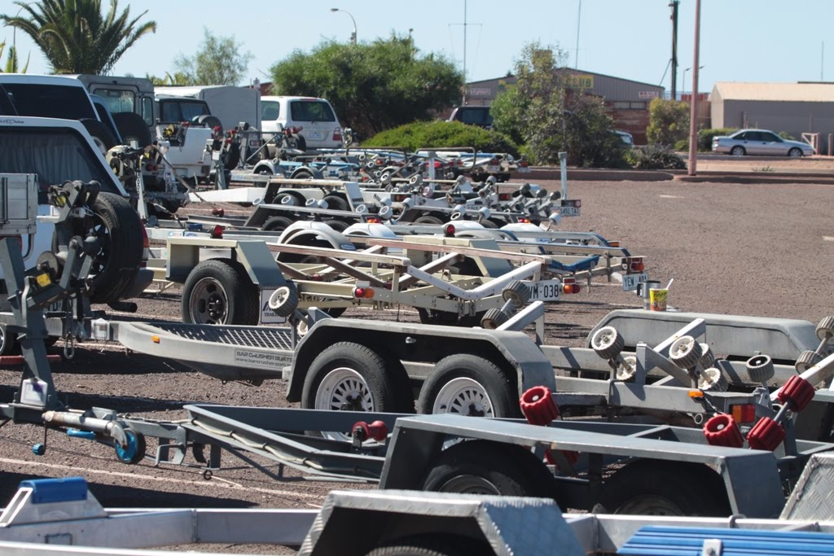
A growing inter-reef fishery

Slide 4
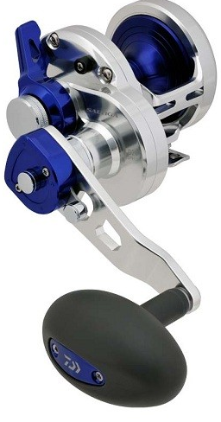
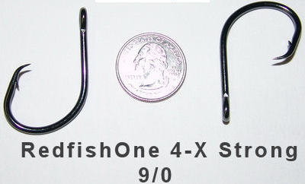
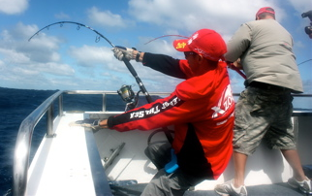
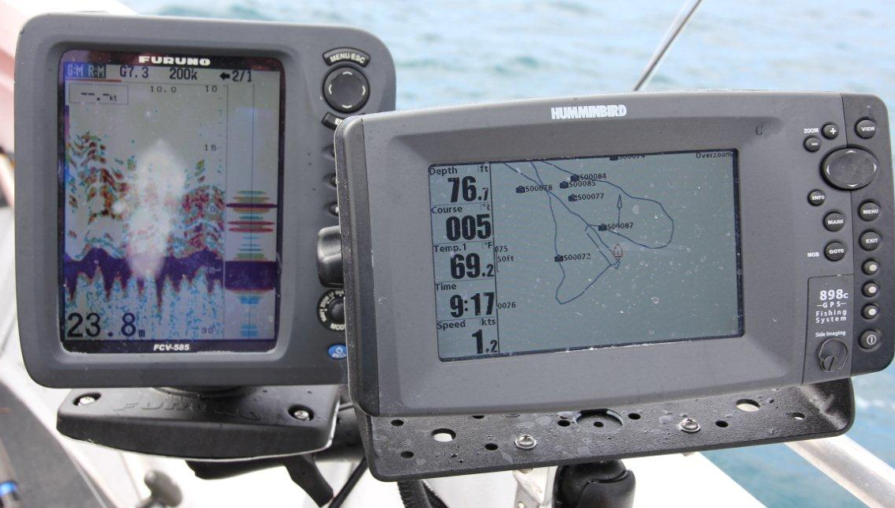
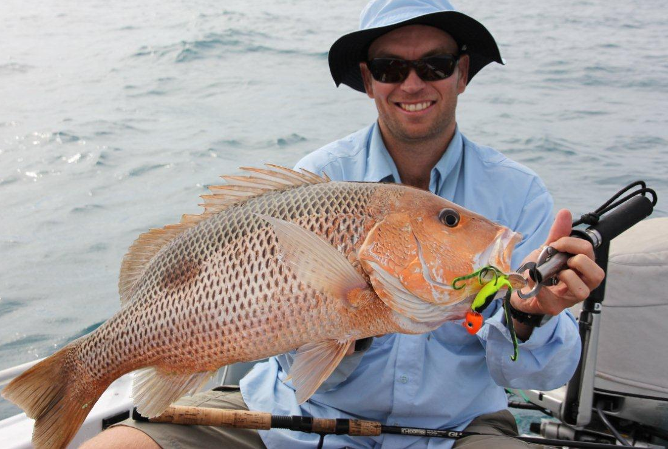
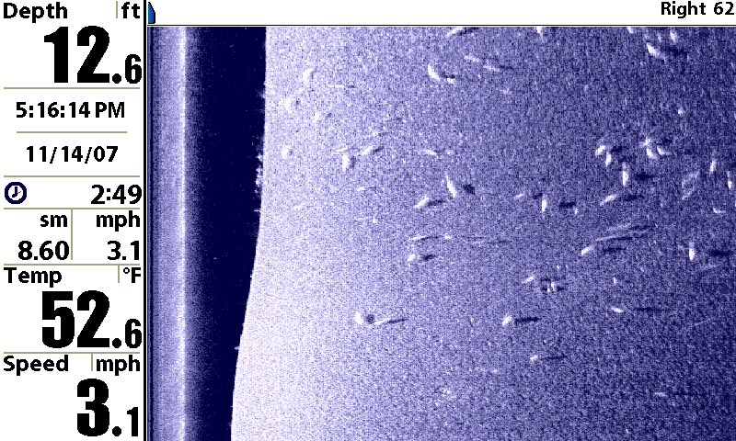
Rapid technological leaps.....
4 stroke outboards
Satellite Navigation plotters
Colour echo-sounders
extremely strong, light, fast fishing reels and rods
very thin braided line…circle hooks...soft plastic lures.....imported bait....

Slide 5
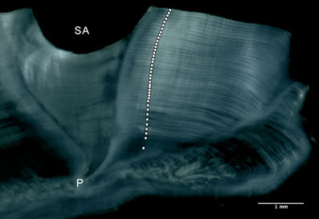
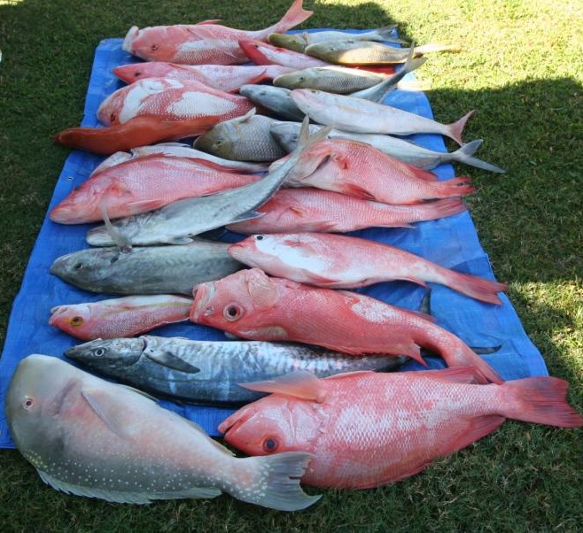
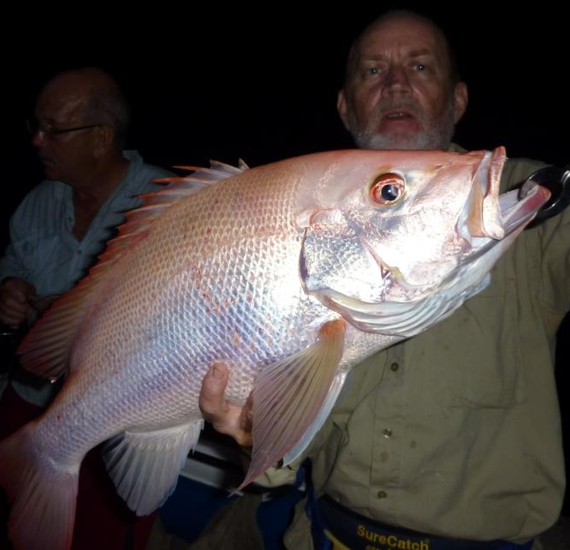
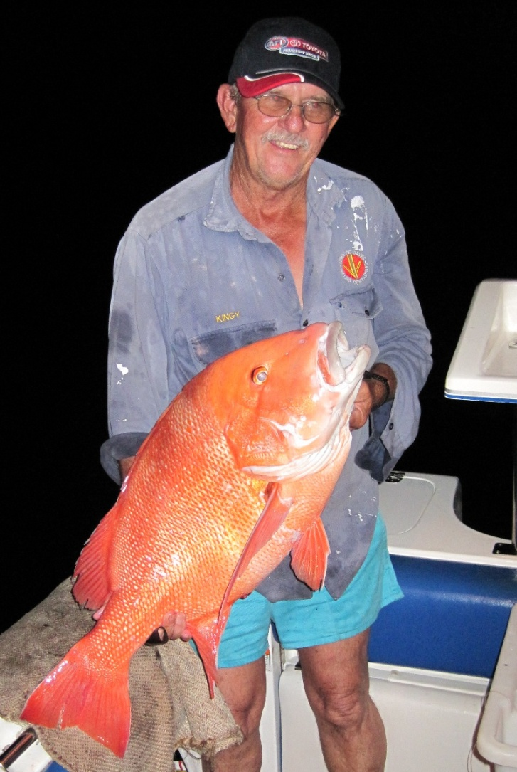
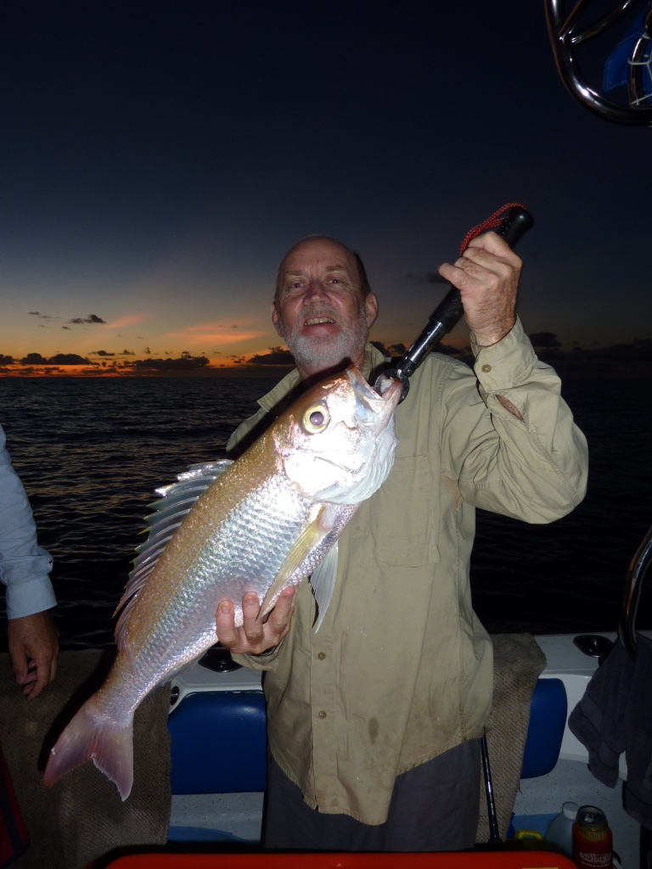
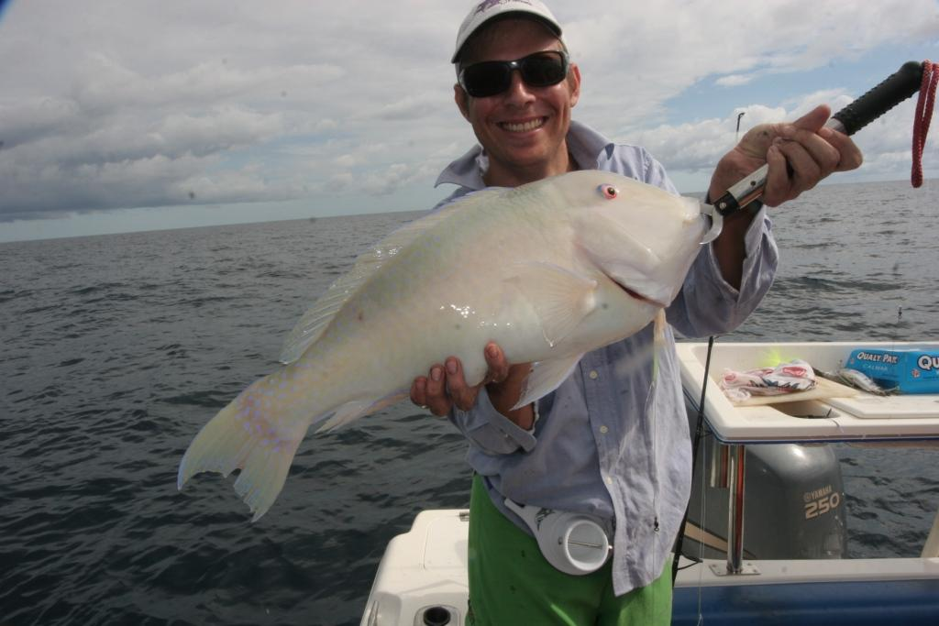
Otolith section
Relatively long-lived target species
45 yr old red emperor
..implies that MPA effects will take a long time to show up....
16 yrs old
17 yrs old
22 yrs old
20 yrs old

Slide 6
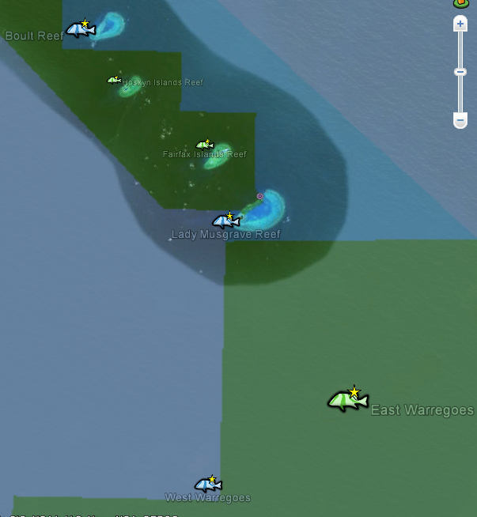
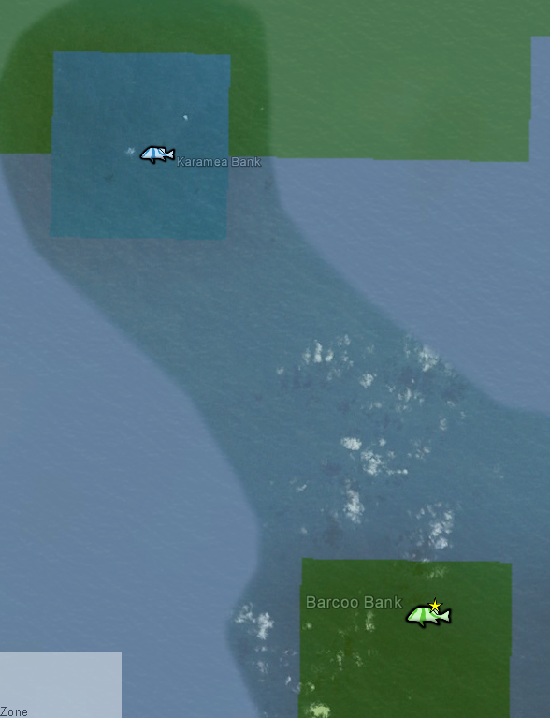
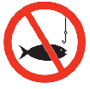
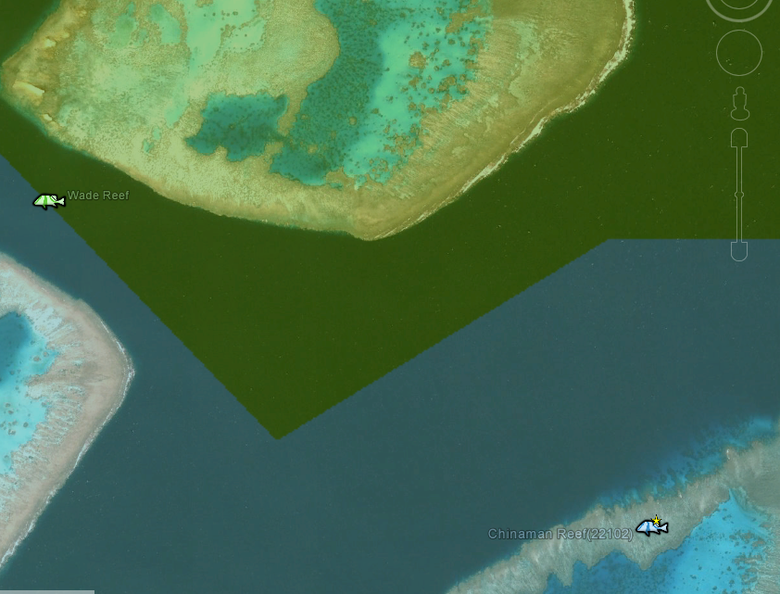
Paired comparisons
“fished” versus “closed in 2004”
Complicated!
by region, habitat, proximity

Slide 7
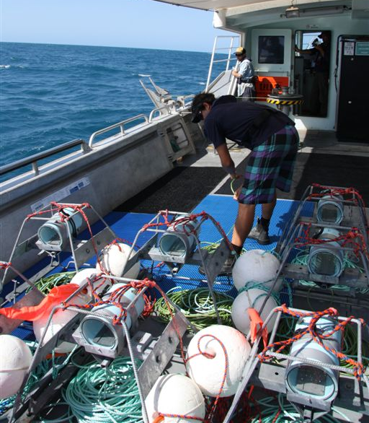
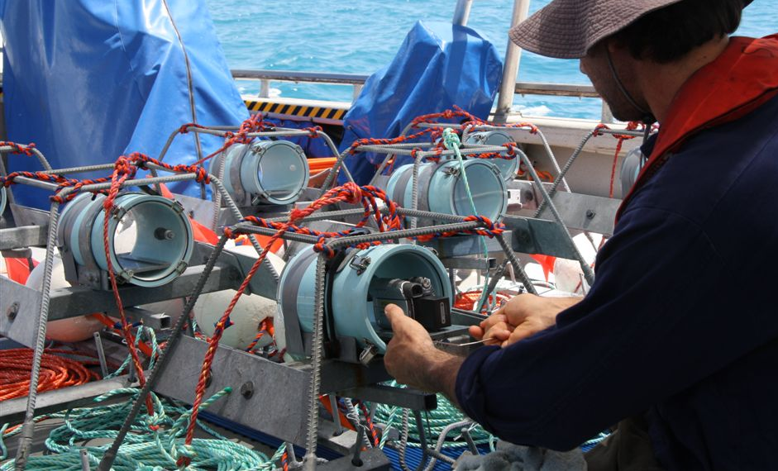
Baited Remote Underwater Video Stations
work 12 BRUVS continuously
one hour sets
kilo of crushed pilchards as bait
Sewer-pipe housings
Cheap
Reliable
<=100metres
Tourist-grade
HandiCams

Slide 8
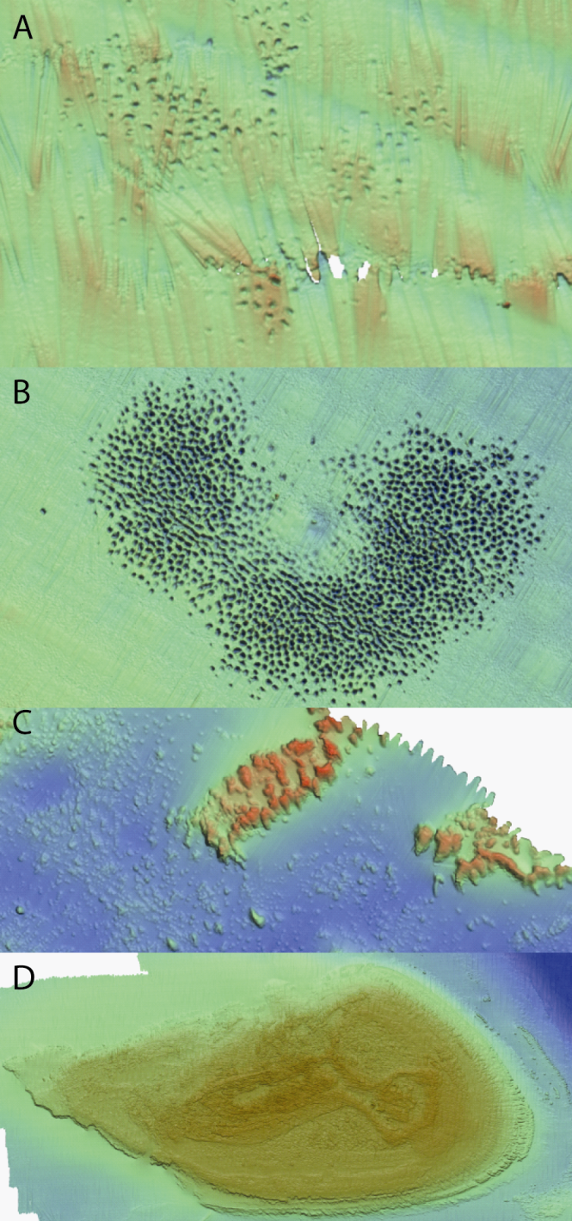
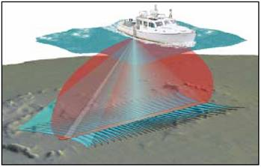
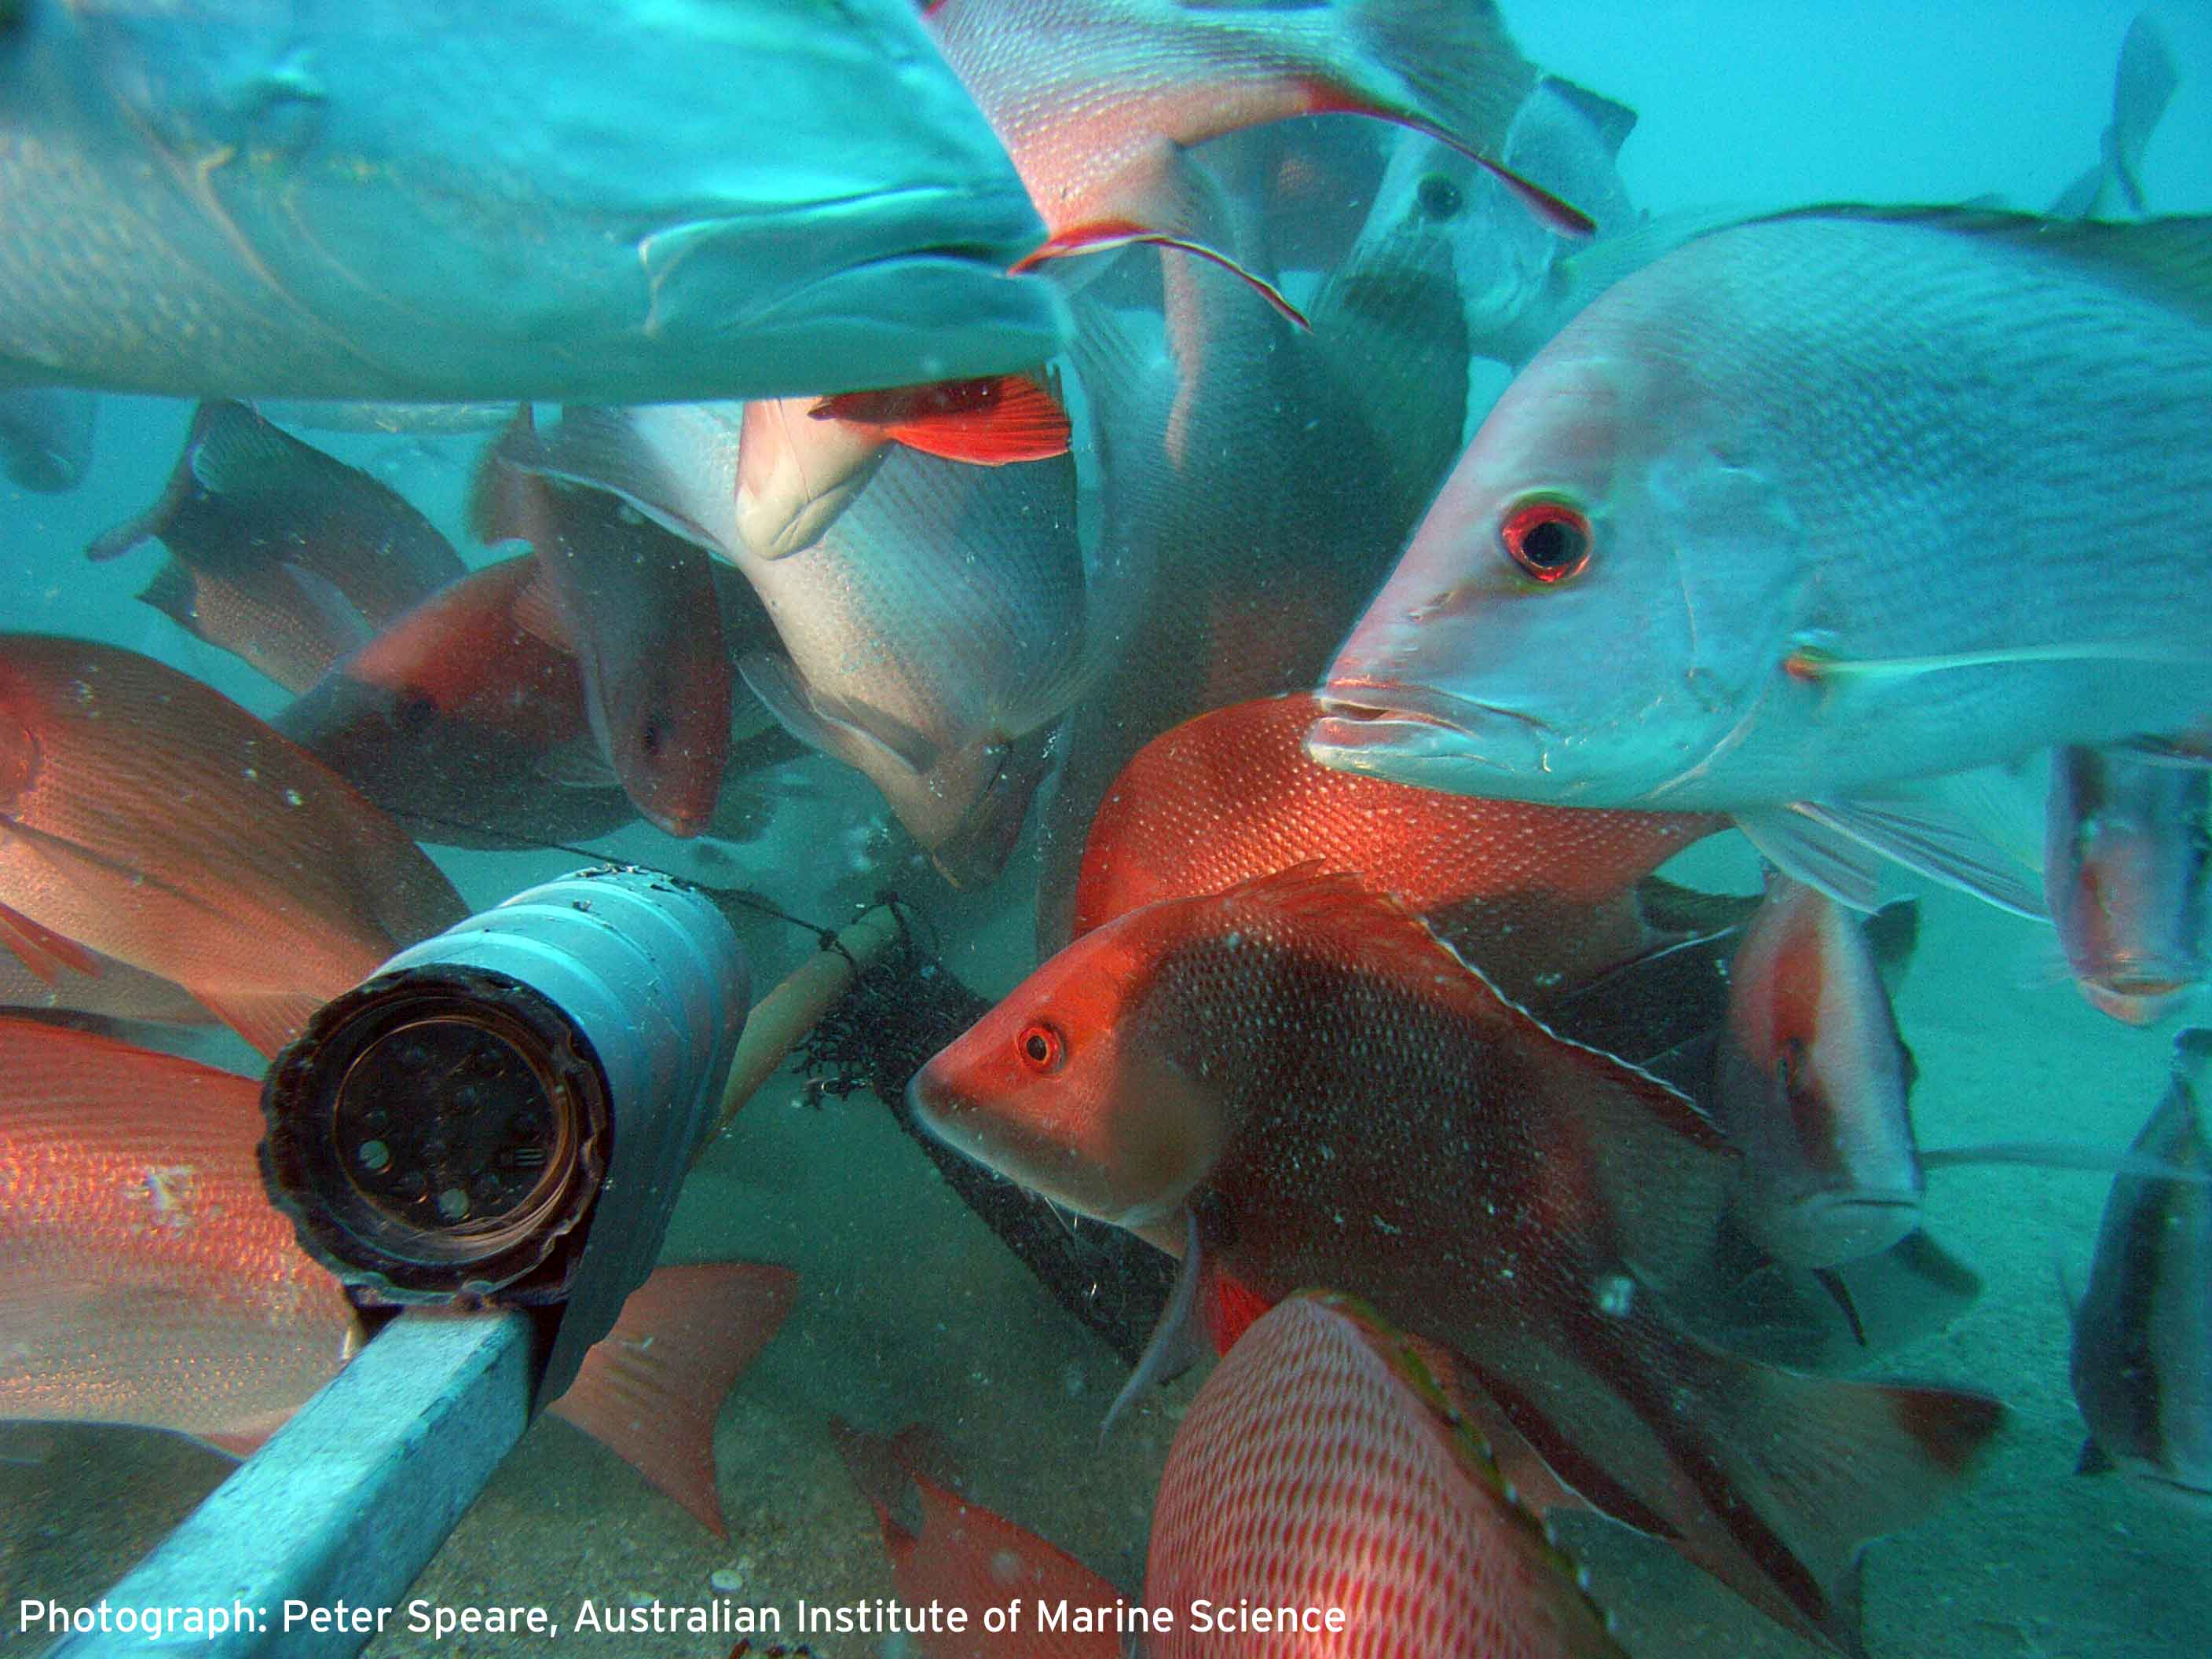
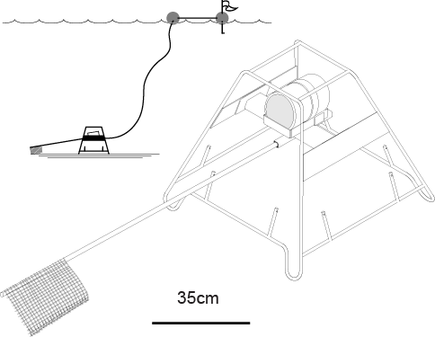
Low-relief shoals, 30-80m deep
“halo of holes”
bare sandy holes, or sparse gorgonians, sponges, sea whips
lutjanids, carangids, labrids, serranids

Slide 9
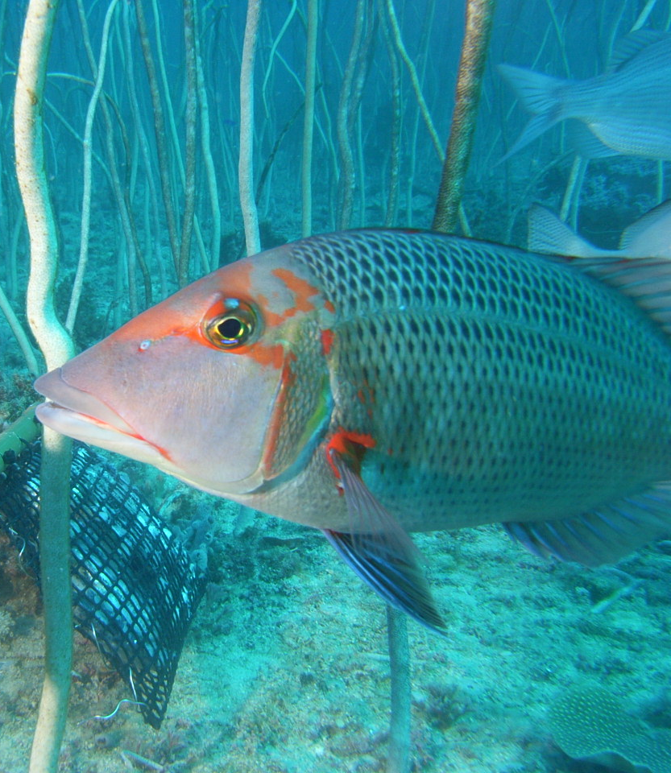
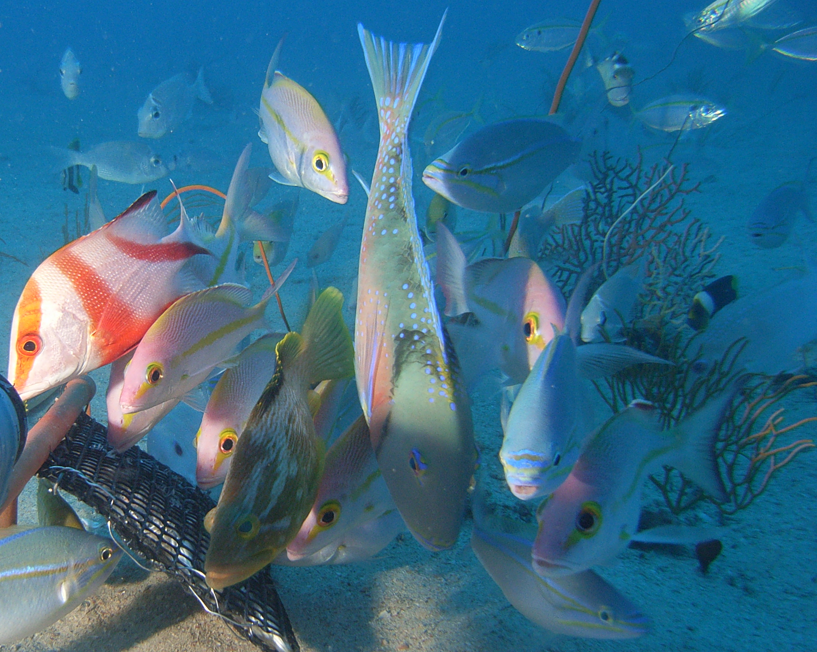
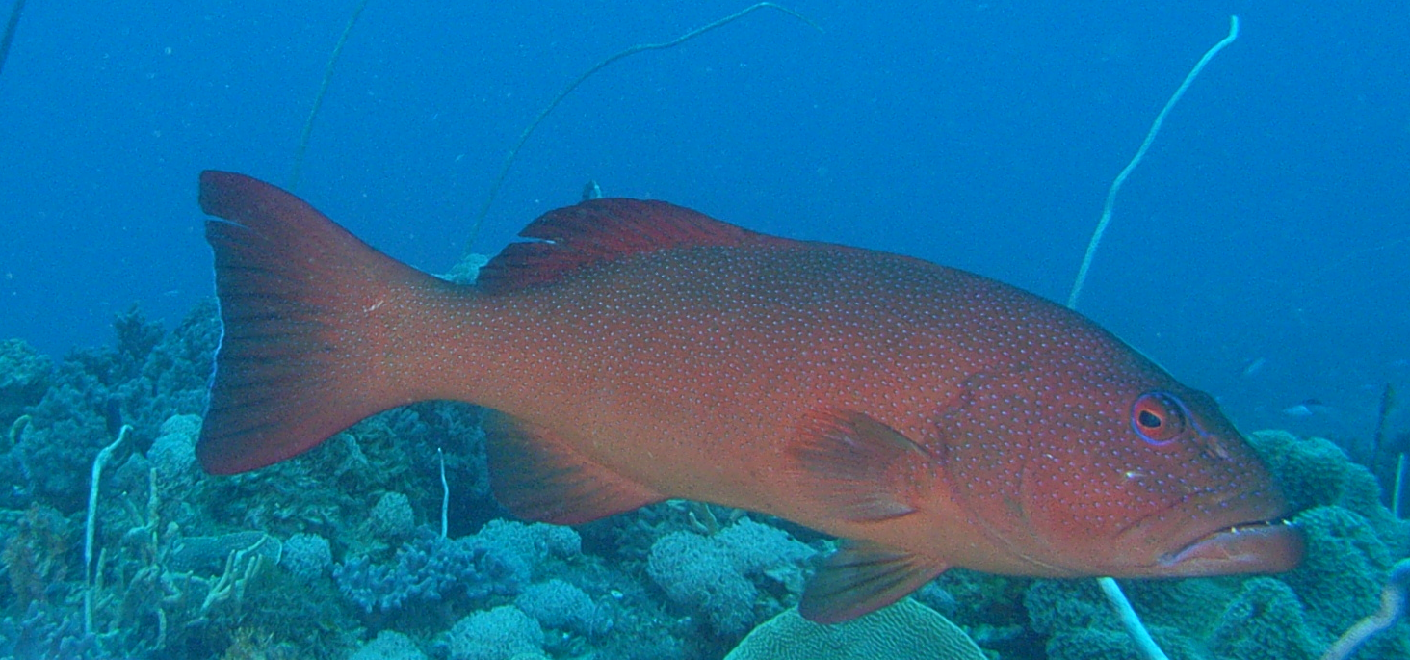
High relief, with megabenthos
Hard corals, gorgonians, sponges, sea whips
lutjanids, lethrinids, serranids, labrids
deep reef bases
sunken banks

Slide 10
Effect size of closure to fishing
Significant effects of regions, habitats and effects of zoning
~glm.nb(habitat + region + zone)
Richness 1.08
All fish 1.14
Unfished (251spp) 1.14
Bycatch (85) 1.05
All targets (30) 1.45
Prized targets (20) 1.48

Slide 11
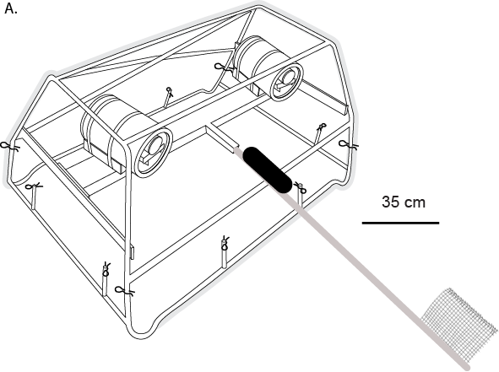
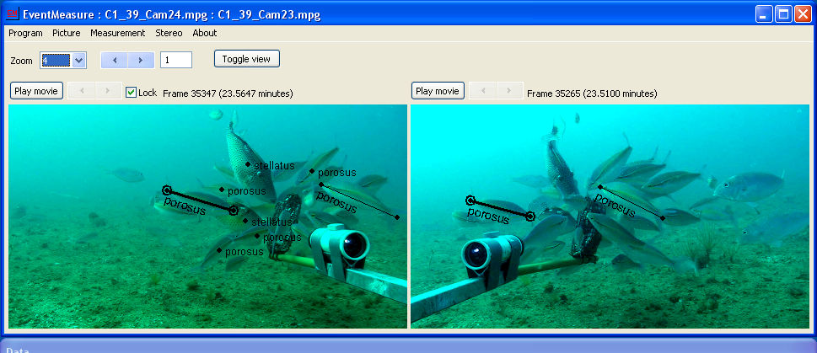
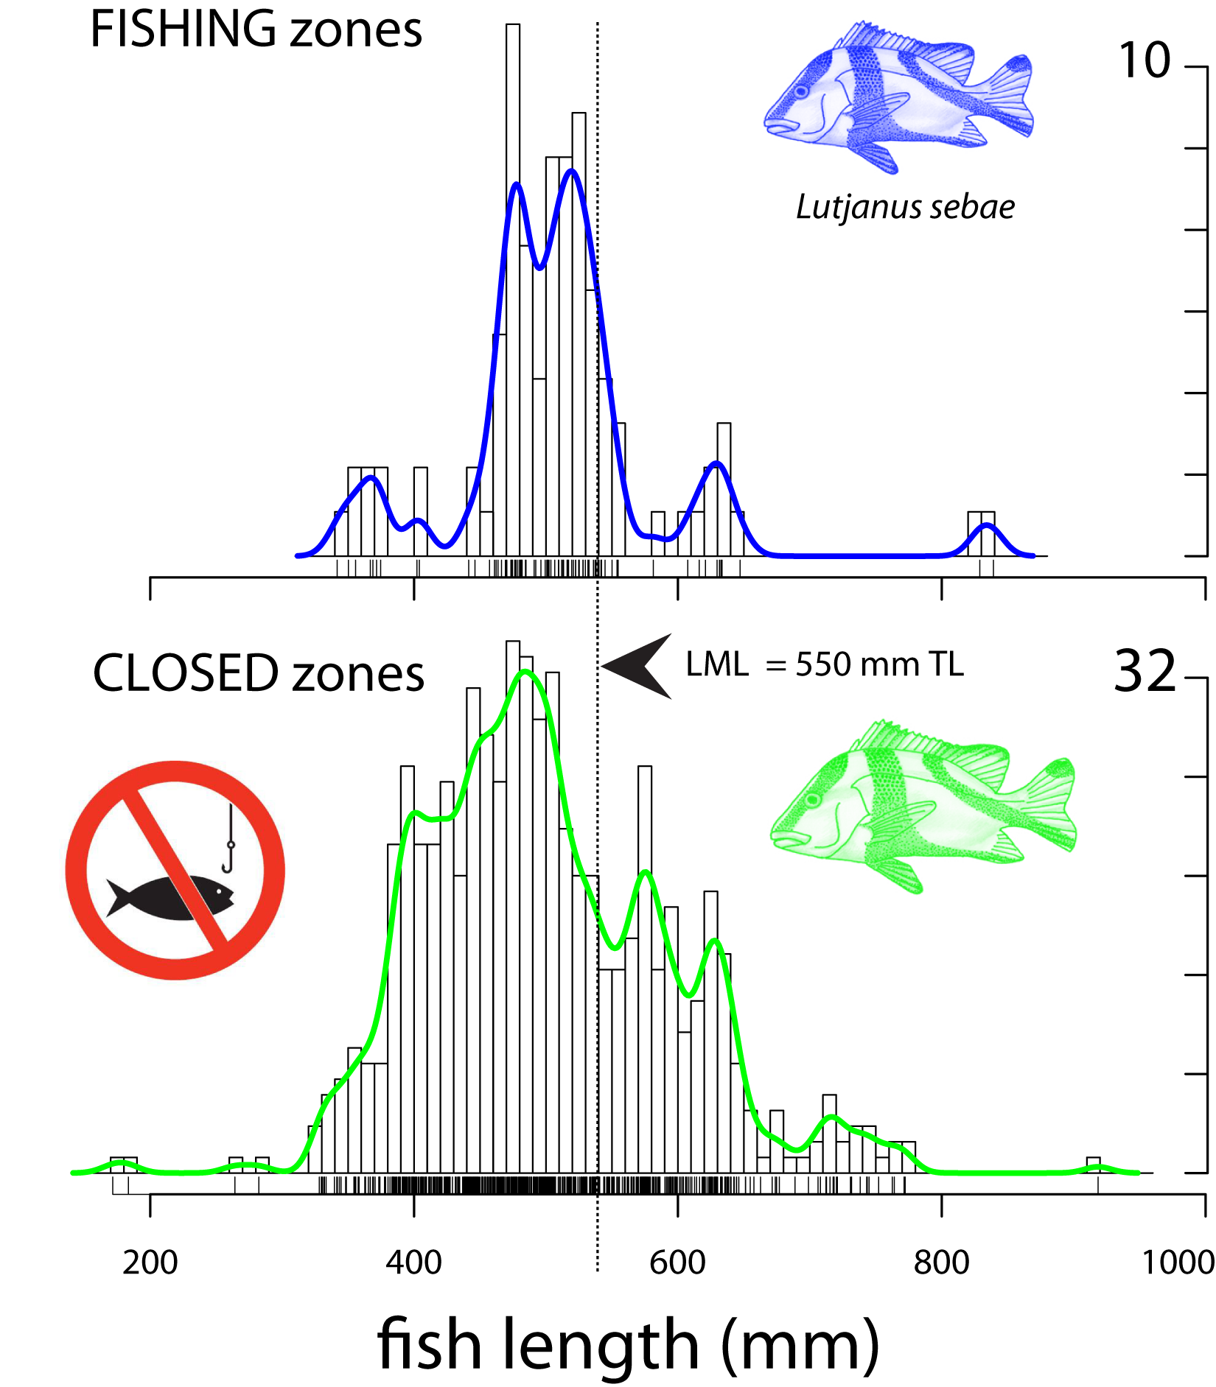
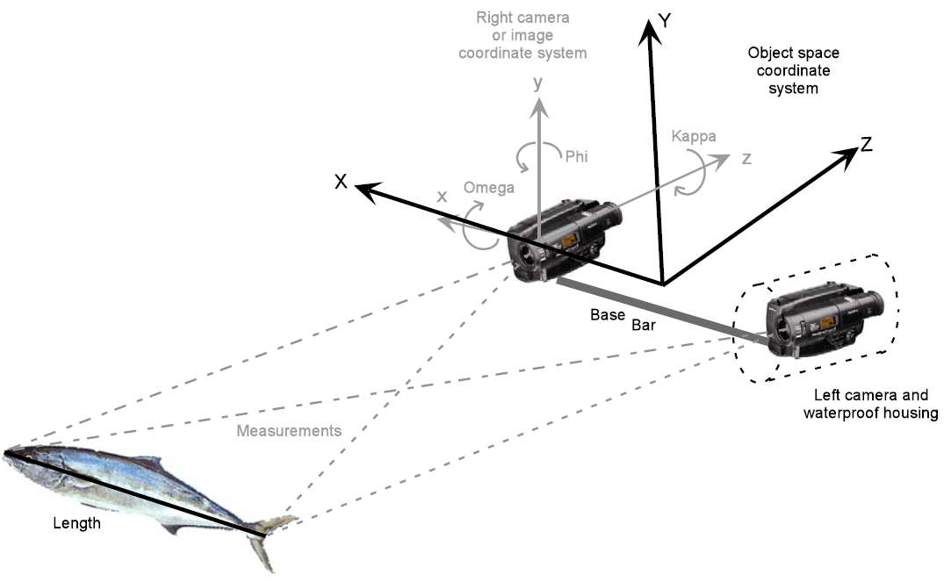
More bigger, older fish in closed zones

Slide 12
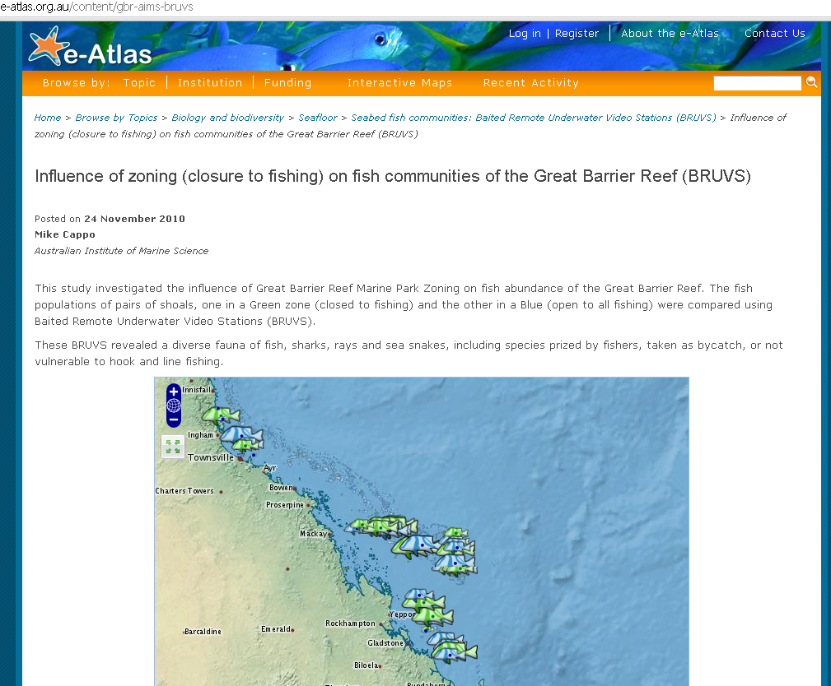
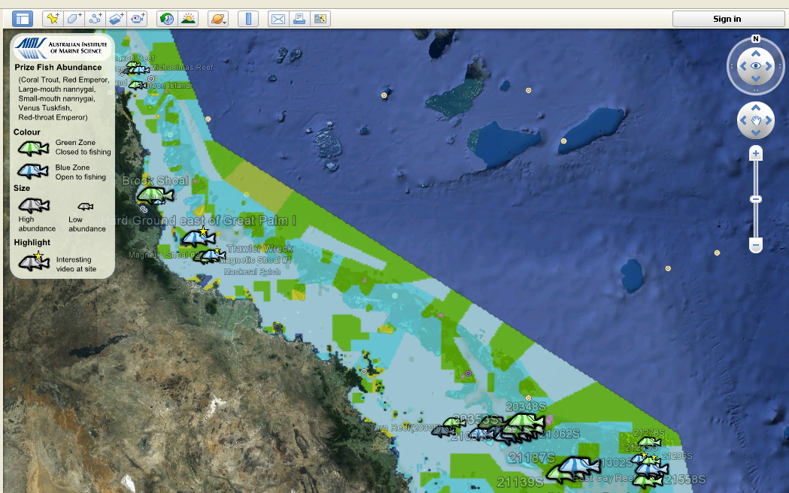
YouTube and Google “Earth”
http://e-atlas.org.au/content/gbr-aims-bruvs
Portray complicated results in map-based use of video footage

Slide 13
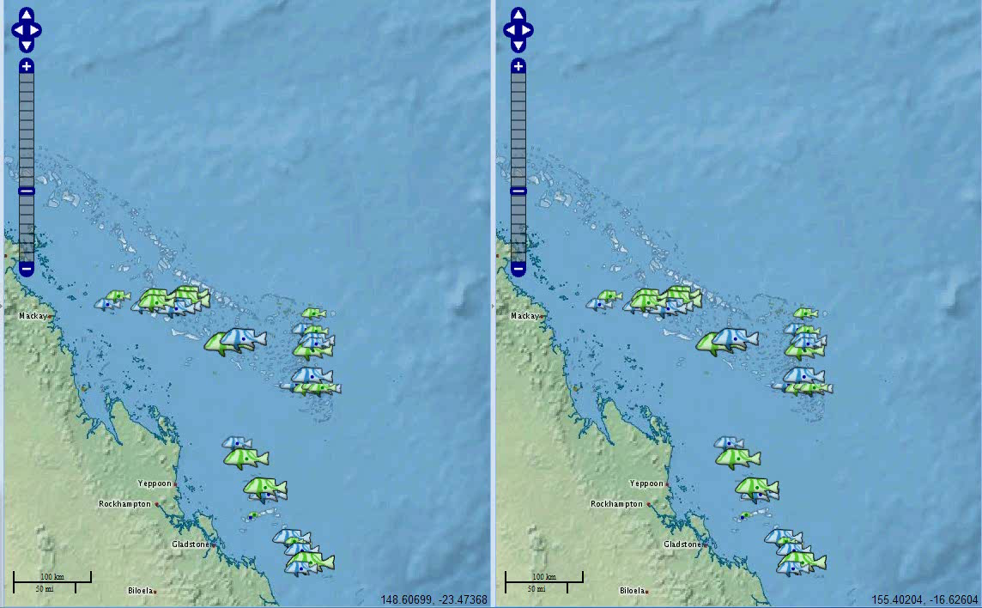


Slide 14
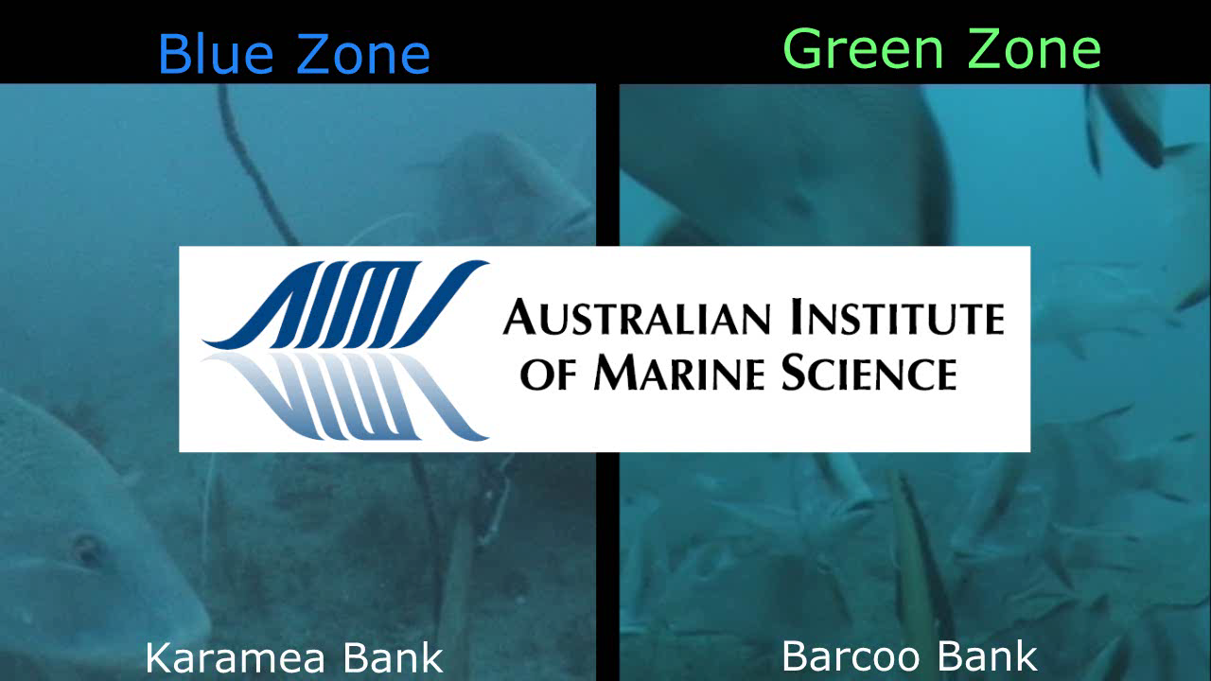

Slide 15
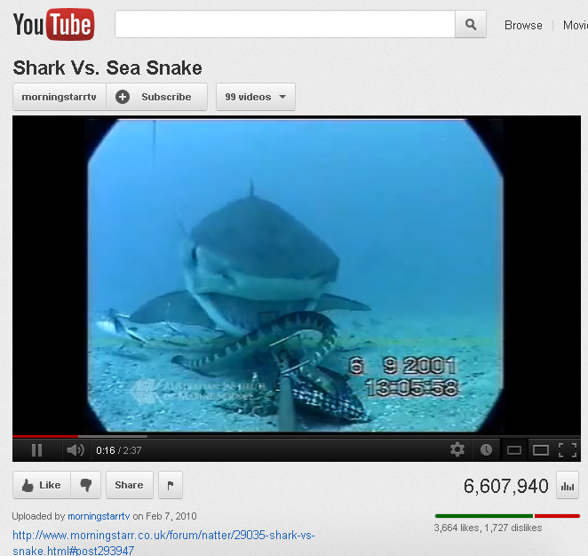
Slow uptake.... Needs some better packaging

